Slide 1
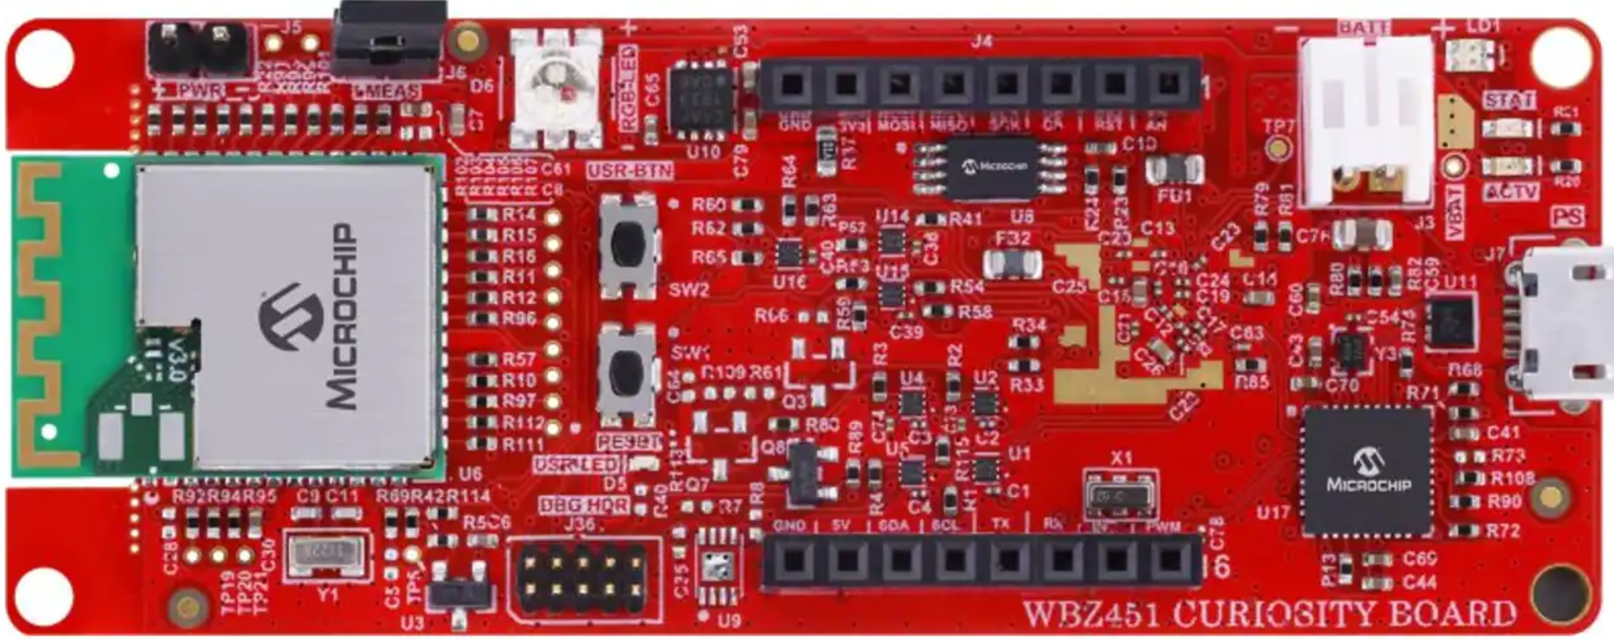
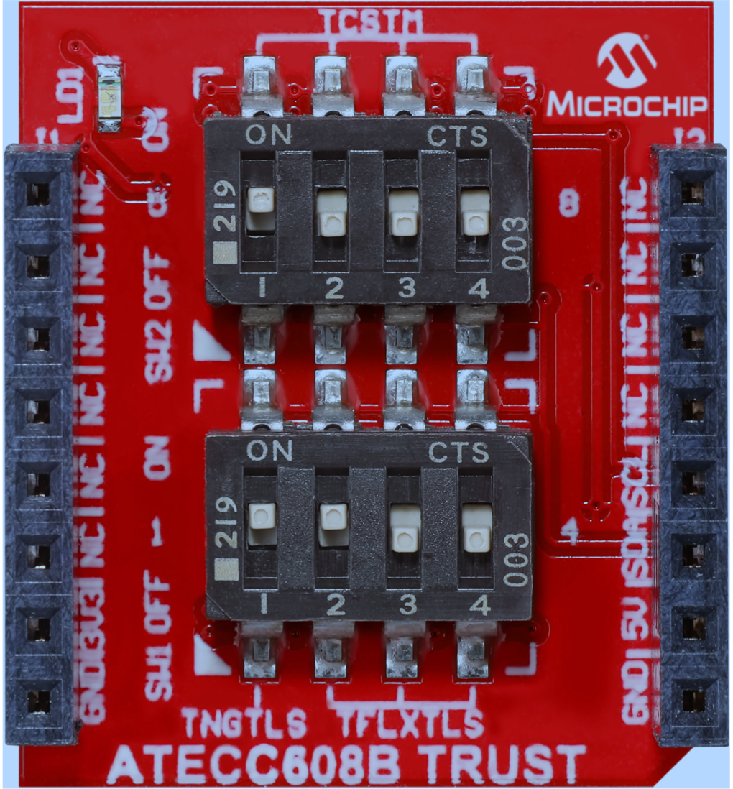
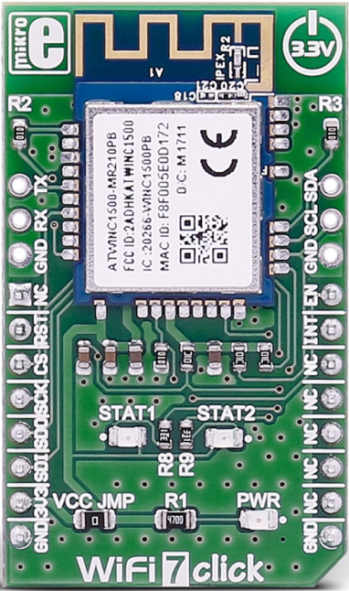





+
+
WBZ451 Curiosity Board
ATECC608B TRUST
WiFi7 click
WBZ451 Curiosity + ATECC608B TRUST
WBZ451 Curiosity + ATECC608B TRUST + WiFi7 click

Slide 2
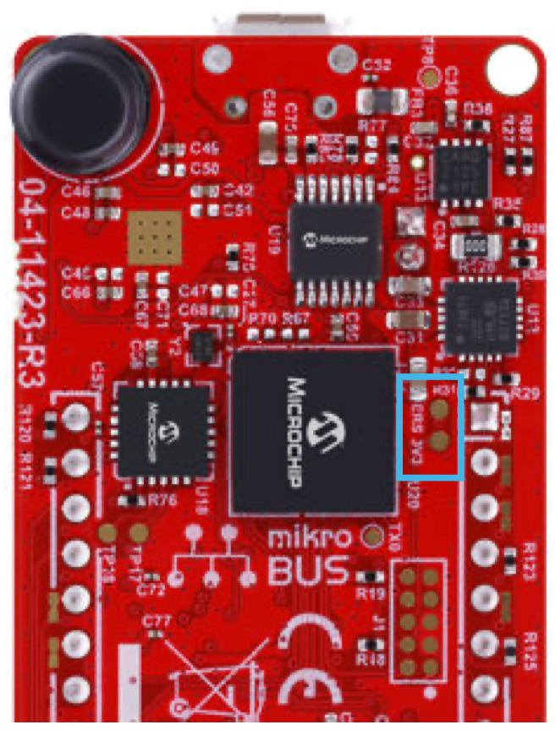
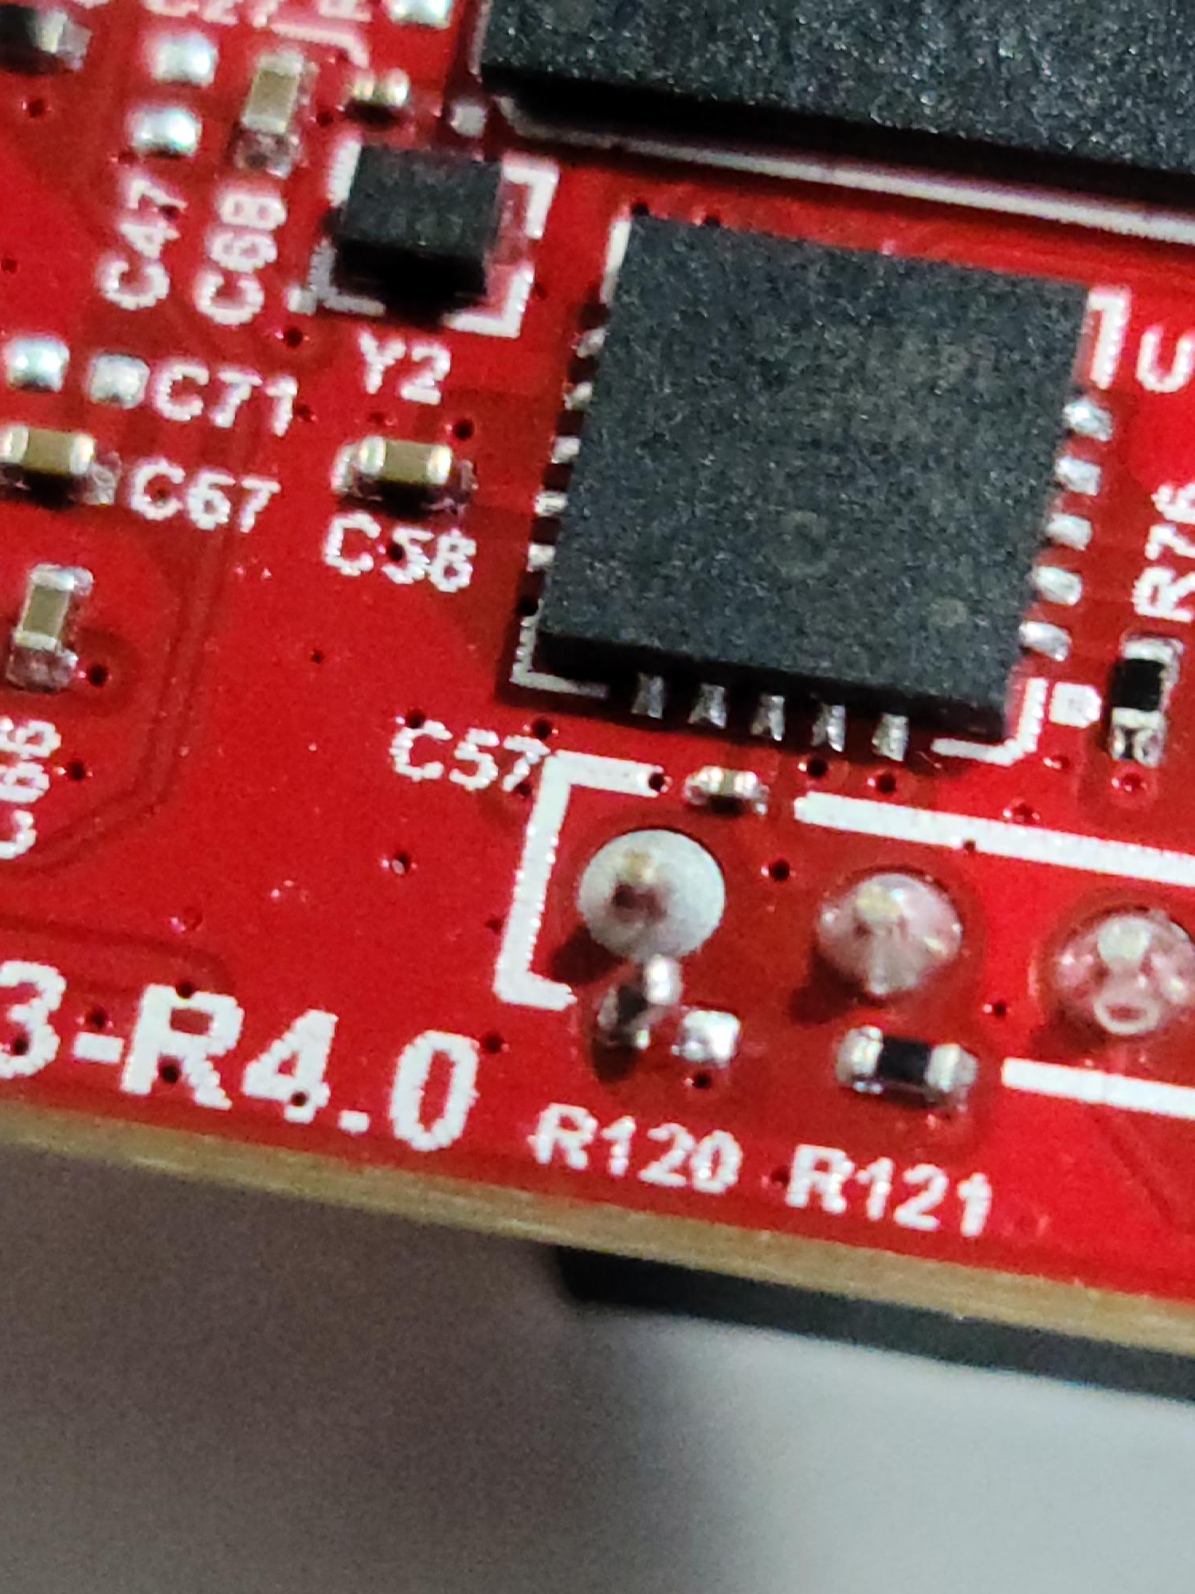
Hardware Modification #1 (WBZ451 Curiosity)
Remove / Lift R120

Slide 3
Hardware Modification #2 (WiFi7 click)
Install jumper wire between NC & EN

Slide 4

Dip Switch Settings (ATECC608B TRUST)
SW2
1 | OFF
2 | OFF
3 | OFF
4 | OFF
SW1
1 | ON
2 | OFF
3 | OFF
4 | OFF

Slide 5
User Buttons (WBZ451 Curiosity)
“USR-BTN” Button
“RESET” Button

Slide 6


BLE-to-Cloud Bridge

